Slide 1
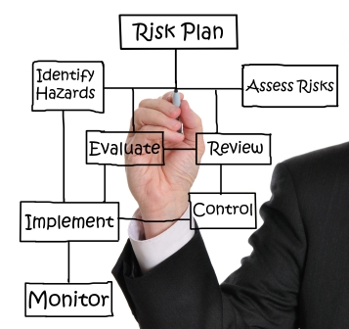
Risk Management: Controlling Risk In information Security

Slide 2
Risk management is the process of identifying vulnerabilities in an organization’s information systems and taking carefully respond steps to ensure the confidentiality, integrity, and availability of all components.
Risk management requires three major undertakings:
Risk identification
Risk assessment
Risk control

Slide 3
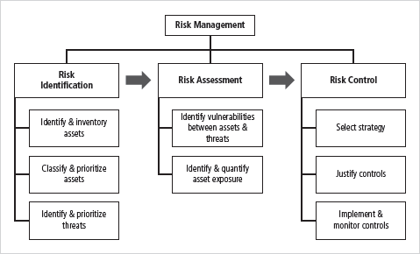

Slide 4
Steps of a risk management plan
Step 1: Identify Risk
Step 2: Assess Risk
Step 3: Control Risk
Steps are similar regardless of context (InfoSec, Physical Security, Financial, etc.)
This presentation will focus on controlling risk within an InfoSec context

Slide 5
Risk Identification
Asset | Asset Type and Subcategory | Asset Function | Priority Level (Low, Medium, High, Critical)
Bob Worker | Personnel: InfoSec | Secure Networks Penetration Testing Make coffee | Low
Cisco UCS B460 M4 Blade Server | Hardware: Networking | Database Server | High
Customer Personally Identifiable Information (PII) | Data: Confidential Information | Provide information for all business transactions | Critical
Windows 7 | Software: Operating System | Employee access to enterprise software | Medium
The steps to risk identification are:
Identify your organization’s information assets
Classify and categorize said assets into useful groups
Rank assets necessity to the organization
To the right is a simplified example of how a company may identify risks

Slide 6
Introduction Risk Identification Risk Assessment
Asset Identification and Inventory
Risk Control Strategies
Qualitative
Points
Iterative process; begins with identification of assets, including all elements of an organizations system (people, procedures, data and information, software, hardware, networking)
Assets are then classified and categorized This process begins with the identification of assets, including all

Slide 7
Introduction Risk Identification Risk Assessment Risk Control Strategies Qualitative
People, Procedures, and Data Asset Identification
Points
Human resources, documentation, and data information assets are more difficult to identify
Important asset attributes:
People: position name/number/ID; supervisor; security clearance level; special skills
Procedures: description; intended purpose; what elements it is tied to; storage location for reference; storage location for update
Data: classification; owner/creator/ manager; data structure size; data structure used; online/offline; location; backup procedures employed

Slide 8
Introduction Risk Identification Risk Assessment Risk Control Strategies Qualitative
Hardware, Software, and Network Asset Identification
Points
Asset attributes to be considered are: name; IP address; MAC address; element type; serial number; manufacturer name; model/part number; software version; physical or logical location; controlling entity
Automated tools can identify system elements for hardware, software, and network components

Slide 9
Introduction Risk Identification Risk Assessment Risk Control Strategies
Data Classification and management
Qualitative
Points
Information owners responsible for classifying their information assets
Information classifications must be reviewed periodically
Most organizations do not need detailed level of classification used by military or federal agencies; however, organizations may need to classify data to provide protection

Slide 10
Introduction Risk Identification Risk Assessment Risk Control Strategies
Classifying and Prioritizing Information Assets
Qualitative
Points
Many organizations have data classification schemes (e.g., confidential, internal, public data)
Categories must be comprehensive and mutually exclusive

Slide 11
Introduction Risk Identification Risk Assessment Risk Control Strategies
Information Asset Valuation (cont.)
Qualitative
Points
Information Asset Prioritization
Create weighting for each category based on the answers to questions
Calculate relative importance of each asset using weighted factor analysis
List the assets in order of importance using a weighted factor analysis worksheet

Slide 12
Introduction Risk Identification Risk Assessment Risk Control Strategies
Identifying and Prioritizing Threats
Qualitative
Points
Realistic threats need investigation; unimportant threats are set aside
Threat assessment:
Which threats present danger to assets?
Which threats represent the most danger to information? How much would it cost to recover from attack?
Which threat requires greatest expenditure to prevent?

Slide 13
Risk Assessment
Threat Agent and Threat | Targeted Asset | Threat Level | Possible Exploits | Risk (Scale of 1-5)
Disgruntled Insider: Steal company information to sell | Company data (i.e. Customer PII) | High | Access control credentials, knowledge of InfoSec policies, etc. | 4.16
Fire: Burn the facility down or cause major damage | Company Facility, Personnel, Equipment | Critical | Mishandled equipment | 2.78
Hacktivists: Quality of service deviation | Company Hardware/Software | Low | Lack of effective filtering | 1.39
The steps to risk assessment are:
Identify threats and threat agents
Prioritize threats and threat agents
Assess vulnerabilities in current InfoSec plan
Determine risk of each threat
R = P * V – M + U
R = Risk
P = Probability of threat attack
V = Value of Information Asset
M = Mitigation by current controls
U = Uncertainty of vulnerability
The table to the right combines elements of all of these in a highly simplified format

Slide 14
Risk control
The steps to risk control are:
Cost-Benefit Analysis (CBA)
Single Loss Expectancy (SLE)
Annualized Rate of Occurrence (ARO)
Annual Loss Expectancy (ALE)
Annual Cost of the Safeguard (ASG)
Feasibility Analysis
Organizational Feasibility
Operational Feasibility
Technical Feasibility
Political Feasibility
Risk Control Strategy Implementation

Slide 15
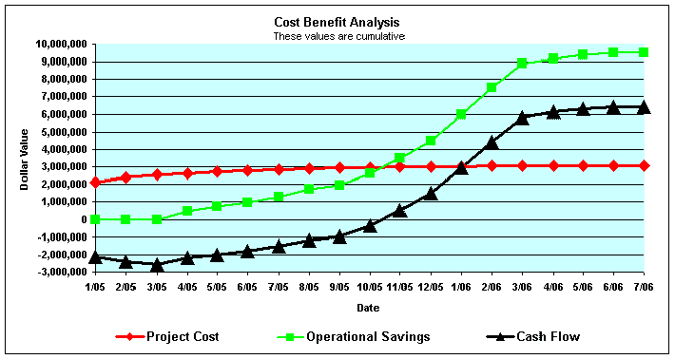
Cost-Benefit analysis
Determine what risk control strategies are cost effective
Below are some common formulas used to calculate cost-benefit analysis

Slide 16
Feasibility analysis
Organizational: Does the plan correspond to the organization’s objectives? What is in it for the organization? Does it limit the organization’s capabilities in any way?
Operational: Will shareholders (users, managers, etc.) be able/willing to accept the plan? Is the system compatible with the new changes? Have the possible changes been communicated to the employees?
Technical: Is the necessary technology owned or obtainable? Are our employees trained and if not can we afford to train them? Should we hire new employees?
Political: Can InfoSec acquire the necessary budget and approval to implement the plan? Is the budget required justifiable? Does InfoSec have to compete with other departments to acquire the desired budget?

Slide 17
Risk control Strategies
Defense
Transferal
Mitigation
Acceptance (Abandonment)
Termination

Slide 18
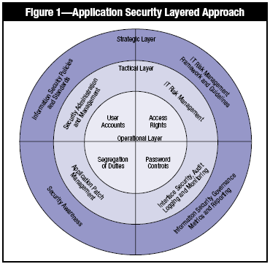
Risk control Strategy: defense
Defense: Prevent the exploitation of the system via application of policy, training/education, and technology. Preferably layered security (defense in depth)
Counter threats
Remove vulnerabilities from assess
Limit access to assets
Add protective safeguards
Notes:
الدفاع: منع استغلال النظام من خلال تطبيق السياسة والتدريب / التعليم والتكنولوجيا. يفضل الأمن متعدد الطبقات (الدفاع في العمق)
مكافحة التهديدات
إزالة نقاط الضعف من التقييم
تقييد الوصول إلى الأصول
أضف ضمانات وقائية

Slide 19

Risk control Strategy: transferal
Transferal: Shift risks to other areas or outside entities to handle
Can include:
Purchasing insurance
Outsourcing to other organizations
Implementing service contracts with providers
Revising deployment models
Notes:
التحويل: تحويل المخاطر إلى مناطق أخرى أو كيانات خارجية للتعامل معها
يمكن أن تشمل:
تأمين المشتريات
الاستعانة بمصادر خارجية لمنظمات أخرى
تنفيذ عقود الخدمة مع مقدمي الخدمة
مراجعة نماذج النشر

Slide 20
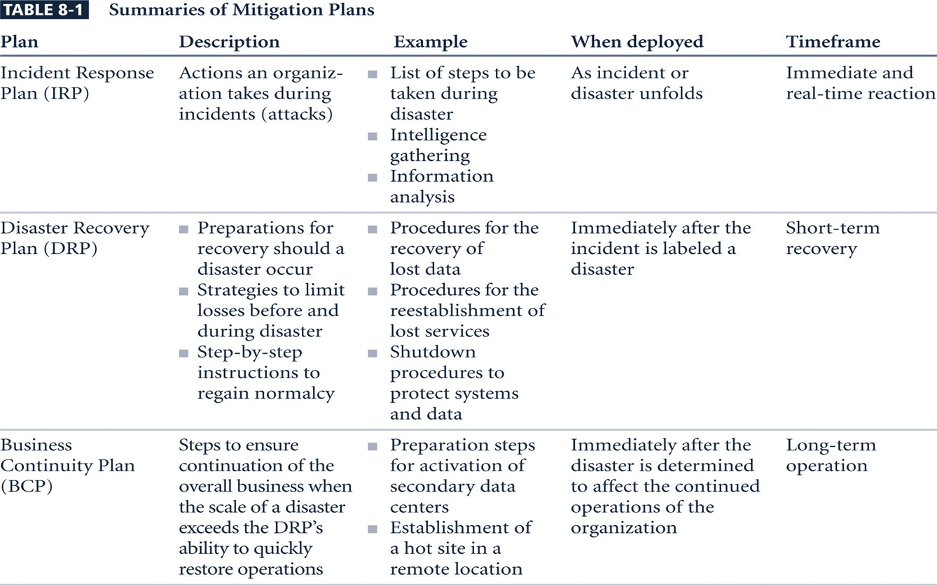
Risk control Strategy: Mitigation
Mitigation: Creating plans and preparations to reduce the damage of threat actualization
Preparation should include a:
Incidence Response Plan
Disaster Recovery Plan
Business Continuity Plan
Notes:
التخفيف: وضع الخطط والاستعدادات لتقليل أضرار تحقيق التهديد
يجب أن يشمل التحضير:
خطة الاستجابة للحوادث
خطة التعافي من الكوارث
خطة استمرارية العمل

Slide 21

Risk control Strategy: Acceptance
Acceptance: Properly identifying and acknowledging risks, and choosing to not control them
Appropriate when:
The cost to protect an asset or assets exceeds the cost to replace it/them
When the probability of risk is very low and the asset is of low priority
Otherwise acceptance = negligence
Notes:
القبول: تحديد المخاطر والاعتراف بها بشكل صحيح واختيار عدم السيطرة عليها
مناسب عندما:
تكلفة حماية الأصول أو الأصول تتجاوز تكلفة استبدالها
عندما يكون احتمال المخاطرة منخفضًا جدًا ويكون للأصل أولوية منخفضة
غير ذلك
القبول = الإهمال

Slide 22
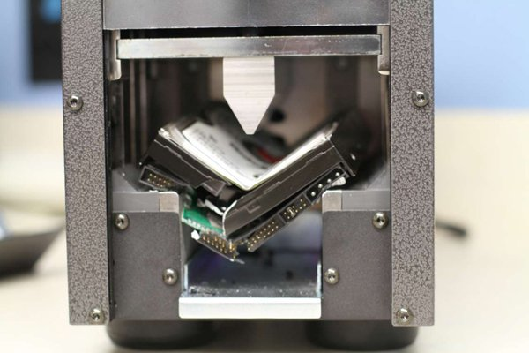
Risk control Strategy: Termination
Termination: Removing or discontinuing the information asset from the organization
Examples include:
Equipment disposal
Discontinuing a provided service
Firing an employee
Notes:
الإنهاء: إزالة أو إيقاف أصول المعلومات من المنظمة
الامثله تشمل:
التخلص من المعدات
وقف الخدمة المقدمة
إقالة موظف

Slide 23
standard approaches to risk management
U.S CERT’s Operationally Critical Threat Assessment Vulnerability Evaluation (OCTAVE) Methods (Original, OCTAVE-S, OCTAVE-Allegro)
ISO 27005 Standard for InfoSec Risk Management
NIST Risk Management Model
Microsoft Risk Management Approach
Jack A. Jones’ Factor Analysis of Information Risk (FAIR)
Delphi Technique
Notes:
معاير قياسية لإدارة المخاطر

